Slide 1
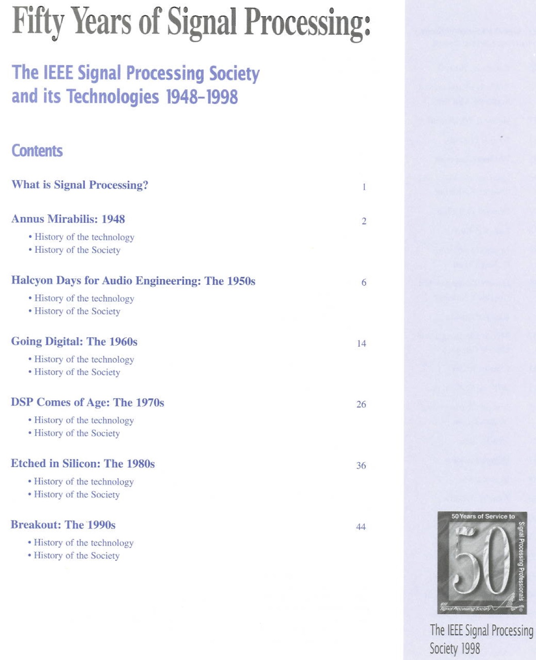
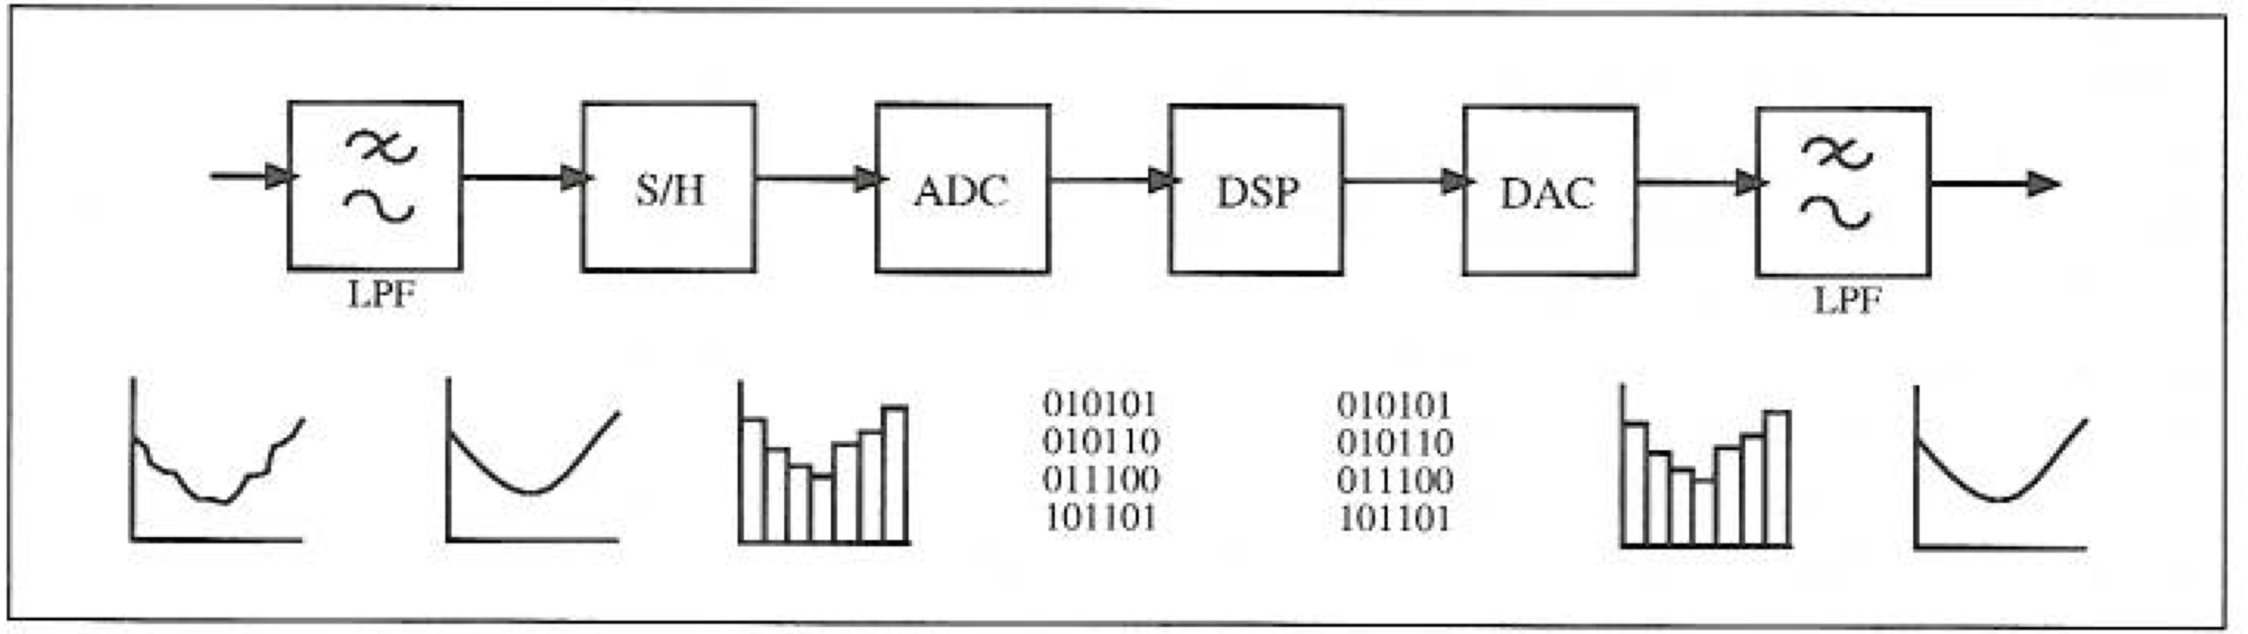
What is Digital Signal Processing?
It is NOT the transmission of signals, as through wires or by radio waves, but the changes made to signals so as to improve transmission or use of the signals
Among the processes are filtering, coding, estimating, detecting, analyzing, recognizing, synthesizing, recording and reproducing!
Craig Marven and Gillian Ewers, A Simple Approach to Digital Signal Processing (New York: John Wiley & Sons, 1996).
Notes:
Look at my function computation slides

Slide 2
Quantization (A/D)
Analog-to-digital (A/D) conversion is achieved by combining sampling and quantization [1].
Sampling converts a time-varying signal into a discrete-time signal, a sequence of real numbers.
Quantization replaces each real number with an approximation from a finite set of discrete values.
[1] Alon Kipnis, Yonina C. Eldar, and Andrea J. Goldsmith. "Analog-to-digital compression: A new paradigm for converting signals to bits." IEEE Signal Processing Magazine 35.3 (2018): 16-39.
Notes:
Quantization is the process of mapping input values from a large set (often a continuous set) to output values in a (countable) smaller set, often with a finite number of elements.
Quantization is involved to some degree in nearly all DSP, as the process of representing a signal in digital form ordinarily involves rounding. Quantization also forms the core of essentially all lossy compression algorithms.
An analog-to-digital converter (A/D) can be modeled as two processes: sampling and quantization. Sampling converts a time-varying voltage signal into a discrete-time signal, a sequence of real numbers. Quantization replaces each real number with an approximation from a finite set of discrete values. Most commonly, these discrete values are represented as fixed-point words.
In quantization, most commonly, these discrete values are represented as fixed-point words.

Slide 3
Sub-Nyquist sampling is optimal under bit-level compression
Nyquist rate sampling is necessary to attain zero distortion without any constraint on the bitrate of the digital representation.
For most signal models, when a distortion constraint is imposed, the minimal distortion can be attained by sampling at a new critical sampling rate that is typically lower than the Nyquist rate [1].
Application:
Multi-resolution video
[1] A. Kipnis, A. J. Goldsmith, and Y. C. Eldar. The distortion-rate function of sampled Wiener processes. IEEE Transactions on Information Theory, 65(1):482–499, Jan 2019.
Notes:
This new critical sampling rate depends on the bitrate of the digital representation and can be precisely derived in many important cases. Furthermore, the theory developed in this work applies regardless if the signal is bandlimited or not. There is a comprehensive signal acquisition theory that includes classical sampling theory in signal processing and lossy compression in information theory as special cases.

Slide 4
Application: Multi-resolution video
The bit rate can be adaptively adjusted to provide a desired resolution (or distortion).
Notes:
It is possible to have adaptation in both resolution and encoding

Slide 5
Sub-Nyquist sampling theory [1]
Three RF transmissions with different carriers f_{i}. The receiver sees a multiband signal (bottom drawing).
The primary goals are efficient hardware implementation and low computational load on the supporting digital processing.
[1] M. Mishali and Y. C. Eldar. "From theory to practice: Sub-Nyquist sampling of sparse wideband analog signals." IEEE Journal of selected topics in signal processing (2010).

Slide 6
Blind Sub-Nyquist sampling Application: Cognitive Radio
In cognitive radio applications, the goal is to sense the available frequency holes in consecutive time intervals [1].
[1] M. Mishali and Y. C. Eldar. "Wideband spectrum sensing at sub-Nyquist rates." arXiv preprint arXiv:1009.1305 (2010).
http://webee.technion.ac.il/Sites/People/YoninaEldar/xampling_modulated_wideband_converter.php
Notes:
Traditional communication, such as television, radio stations, mobile carriers and air traffic control is carried over predetermined frequency bands. Over the years, government agencies allocated the majority of the spectrum to legacy users, reserving a particular frequency interval for each owner. This resource allocation strategy has led to spectrum congestion, to such a point that, today, the increasing demand for transmission bands can rarely be satisfied by a permanent allocation. Fortunately, studies conducted by the Federal Communications Commission (FCC) in the United States and by similar agencies in other countries indicate that the spectrum is underutilized; In a given geographical location and time duration, only a small number of legacy users transmit concurrently. This low frequency utilization, illustrated in Figure, is what drives CR technology.

Slide 7
Blind Sub-Nyquist sampling: Signal Model
Blind sub-Nyquist sampling of multiband signals: unknown frequency support occupies only a small portion of a wide spectrum.
[1] M. Mishali and Y. C. Eldar. "Wideband spectrum sensing at sub-Nyquist rates." arXiv preprint arXiv:1009.1305 (2010).
http://webee.technion.ac.il/Sites/People/YoninaEldar/xampling_modulated_wideband_converter.php
Notes:
the input x(t) has multiband spectra with energy that concentrates on N frequency intervals of individual widths B located anywhere below some maximal frequency f_{max}.

Slide 8
Blind Sub-Nyquist sampling: Union of Spectrum Slices
The acquisition stage generates a set of sampling sequences y_{i}[n], where each sequence is a linear mixture of spectrum slices.
The aliasing allows to reduce the bandwidth to a narrow range of frequencies which can be sampled at a low rate.
In the digital domain we can resolve the aliasing by suitable processing.
http://webee.technion.ac.il/Sites/People/YoninaEldar/xampling_modulated_wideband_converter.php
Notes:
Since each combination of carrier frequencies determines a single subspace, a multiband signal can be described in union terminology by indexing the possible spectral supports with \lambda and letting A_\lambda capture the signal content on the chosen support. In principle, f_{i} lies in the continuum [0,f_{max}] in this modeling, so that the union contains infinitely many subspaces. A different viewpoint is to divide the Nyquist range to M slices and enumerate the possible supports according to the slice indices that contain signal energy. This approach results in a finite union of bandpass subspaces.
Mathematically, the aliasing is captured by the following system of equations:
y[n]=Cz[n]
The vector y[n] has length m, as the number of sampling sequences that the hardware produces. The vector z[n] has length M, with entries corresponding to the spectrum slices. Typically, m<M so that the total sampling rate is below Nyquist. The approaches below realize this viewpoint using different analog compression techniques. Recovery from y[n] is described afterwards.

Slide 9
Blind Sub-Nyquist sampling: X-ADC via Periodic Nonuniform Sampling
Nyquist interval
Periodic nonuniform sampling is obtained by selecting a sampling pattern of m points within an interval of length MT, where T is the Nyquist interval, and repeating this sampling pattern on consecutive intervals of length MT.
http://webee.technion.ac.il/Sites/People/YoninaEldar/xampling_modulated_wideband_converter.php
Notes:
In this approach, we define y_{i}[n] for the uniform sequence corresponding to the sampling points in shift c_{i}T. The sensing matrix C in this approach is a partial DFT matrix.

Slide 10
Compressive (Compressed) Sensing
Acquire and sample (A/D converter)
Compress (signal dependent, nonlinear)
Question: can we directly acquire JUST the useful part of the signal?
Emmanuel Candès, “Compressive sensing – a 25 Minute Tour”, First EU-US Frontiers of
Engineering Symposium, Cambridge, September 2010 .

Slide 11
What is Compressive Sensing?
Can obtain super-resolved signals from just a few sensors
Sensing is nonadaptive: no effort to understand the signal!
Simple acquisition process followed by numerical optimization
Transform coefficients
(Sparsity)

Slide 12
What do we mean by sparsity?
x: signal coefficients in our convenient representation
collect information by measuring largest components of x
Applications: A/D conversion, Optical systems, Magnetic Resonance Imaging
Even if the positions of nonzero coefficients are not known in advance, it is possible to reconstruct x (if x is sparse).

Slide 13
Implication of sparsity: image “compression”
Set to zero all but the 25,000 largest coefficients
Invert the transform
Underlying principle in modern lossy coders (sound, image, video)!
Notes:
Take 96K incoherent measurements of “compressed” image
Compressed image is perfectly sparse (25K nonzero wavelet coeffs)
Solve l1

Slide 14
Group Testing Problem
Break items (signal values) into groups
Measure information on groups using binary vectors
Interpret results as positive or negative
Recover identity of heavy items, and their values
Continue (somehow) until all coefficients are found
General benefit: fast decoding

Slide 15
Group testing
Robert Dorfman (1943) founded the subject of group testing by noting that, for syphilis testing (WW2), the total number of tests needed could be dramatically reduced by pooling samples [1].
One can take blood samples from a pool (or group) of many soldiers, mix the samples, and perform the syphilis test on the pooled sample.
The test should report whether or not any syphilis antigens are present in the combined sample.
Test is negative -> all the soldiers in the pool are free of syphilis.
Test is positive -> at least one soldier in the pool must have syphilis.
One can use several such tests to discover which soldiers have syphilis, using fewer tests than the number of soldiers.
[1] R. Dorfman. The detection of defective members of large populations. The Annals of Mathematical Statistics, 1943.

Slide 16
A group testing procedure and its outcomes
Individuals
Testing matrix
X
Tests
Icons for defective individuals (items 3 and 5) are filled, and icons for nondefective individuals are unfilled.
X is the testing matrix, where elements x_{ti} are circled for emphasis if x_{ti} = 1 and individual i is defective.
A test is positive if and only if it contains at least one circled 1.

Slide 17
Group testing inference problem: Which individuals are defective?
We write
1 for a positive test and
0 for a negative test.
The defectivity status of the individuals is now unknown, and we hope to infer it from the outcomes y and matrix X.

Slide 18
Distributed Compressed Sensing (DCS)
The DCS theory rests on a new concept (the joint sparsity of a signal ensemble).
Sarvotham, Shriram, et al. "Distributed compressed sensing of jointly sparse signals." Asilomar conference on signals, systems, and computers. 2005.
G. Cormode, and S. Muthukrishnan. "Combinatorial algorithms for compressed sensing." International colloquium on structural information and communication complexity. Springer, Berlin, Heidelberg, 2006.
Notes:
Baron, Dror, et al. "An information-theoretic approach to distributed compressed sensing." Proc. 45rd Conference on Communication, Control, and Computing. 2005.

Slide 19
Graph Signal Processing
Why?: Data is often structured [1]
[1] Xiaowen Dong, “Graph signal processing Concepts, tools and applications in neuroscience,” Oxford-Man Institute, NISOx, Big Data Institute, Feb. 2019.

Slide 20
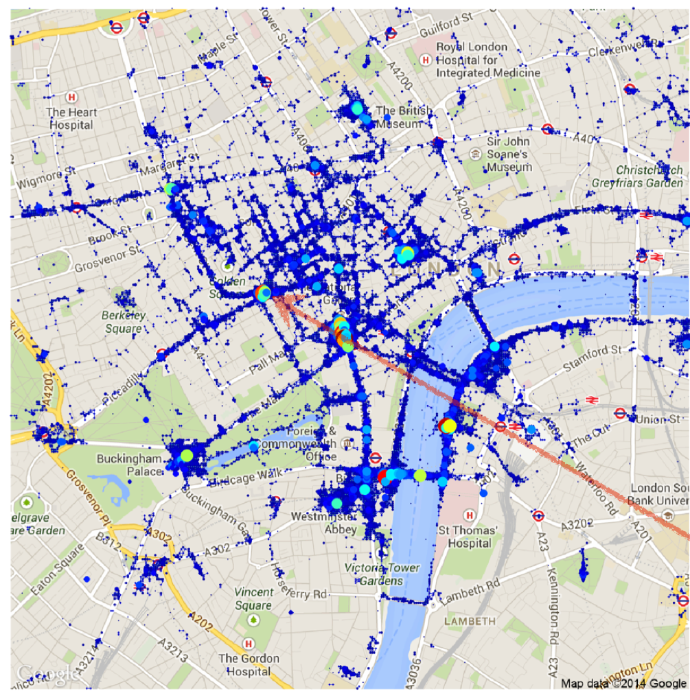
Graph Signal Processing
Why?: Graph signals are pervasive [1]
Social network
Vertices: 1000 Twitter users
Edges: following relationship between users
Geographic network
Vertices: 9000 grid cells in London
Edges: geographical proximity of grid cells
Brain network
Vertices: brain regions
Edges: structural connectivity between brain regions
[1] Xiaowen Dong, “Graph signal processing Concepts, tools and applications in neuroscience,” Oxford-Man Institute, NISOx, Big Data Institute, Feb. 2019.

Slide 21
Graph Signal Processing
https://www.semanticscholar.org/paper/Introduction-to-Graph-Signal-Processing-Stankovi%C4%87-Dakovi%C4%87/c9bf8dfb06018aac5c49d625d7b244546d446ba8

Slide 22
Graph Signal Processing
https://www.semanticscholar.org/paper/Introduction-to-Graph-Signal-Processing-Stankovi%C4%87-Dakovi%C4%87/c9bf8dfb06018aac5c49d625d7b244546d446ba8

Slide 23
Graph Signal Processing
https://www.semanticscholar.org/paper/Introduction-to-Graph-Signal-Processing-Stankovi%C4%87-Dakovi%C4%87/c9bf8dfb06018aac5c49d625d7b244546d446ba8

Slide 24
Graph Signal Processing
https://www.semanticscholar.org/paper/Introduction-to-Graph-Signal-Processing-Stankovi%C4%87-Dakovi%C4%87/c9bf8dfb06018aac5c49d625d7b244546d446ba8

Slide 25
Graph Signal Processing
Applications
Inferring network topology
Graph clustering (community detection)
Diffusion on graphs
Applications in neuroscience
Understanding brain functioning
Disease classification
Gender classification
Inferring brain connectivity

Slide 26
Graph Signal Processing
Signal recovery on graphs
Linear filtering in graphs (or networks)
Graph downsampling
Graph filter banks
Sparse graph codes
Each cluster has similar data
Noise cancelation of a sensor array thanks to graph signal processing.
https://perraudin.info/gsp.php

Slide 27
Other Topics in Signal Processing
Power spectrum estimation (Ch 14)
Power spectral density (PSD) (Fourier transform of autocorrelation)
Filter structures
How to find different ways to implement IIR, FIR filters (polyphase, etc.)
Image and video processing
Principle component analysis
Graph signal processing
Hardware/implementation
Speeding up distributed signal processing
Distributed group testing
Distributed compressed sensing
Distributed estimation
Distributed machine learning
Applications: Computer vision, self-driving cars, speech recognition, spectrogram, Image processing, robotics
Notes:
Graph filter bank that splits the graph signal into two bandlimited graph signals. In each channel, we perform sampling and interpolation, following Theorem 1. Finally, we add the results from both channels to obtain the original full-band graph signal.
(DFT/WHT – cite Ramchandran’s papers)
Walsh Hadamard Transformation(WHT)
Comparison of FFT, DCT, DWT, WHT Compression Techniques on Electrocardiogram & Photoplethysmography Signals

Slide 28
Spring 2021: ECSE 4560/6560 Digital Communications
The Depiction of a General Communication System*
*Shannon, Claude Elwood. "A mathematical theory of communication." Bell system technical journal 27.3 (1948): 379-423.

